Slide 1
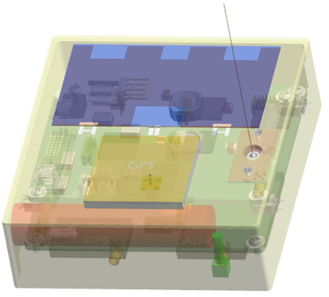
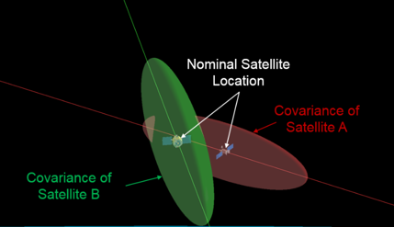
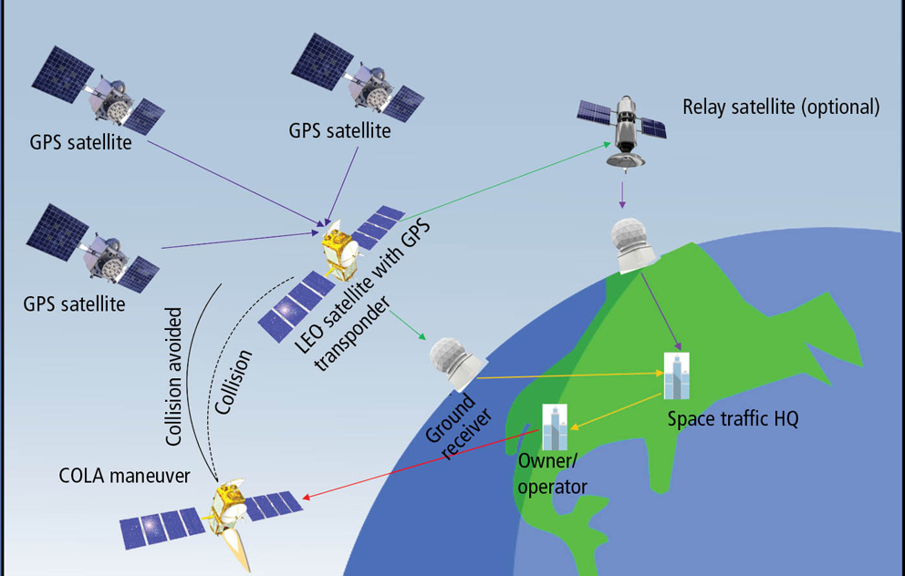
EXAMPLE (DELETE)
Blinker: SPACE TRAFFIC MANAGEMENT TRANSPONDER
A low-SWaP transponder device for simplified identification and tracking of space objects
Similar to ADS-B transponders in the aviation world, BLINKER is a low-cost GPS-based transponder that broadcasts a space object’s position vectors—and its identity
What if anything in space—alive or dead—could transmit to operators what it is and where it is?
Dedicated GPS Transponder Payload for Safe, Scalable Space Traffic Management
Current methods for tracking and cataloguing objects in space primarily involve ground-based optical and radar sensor networks. These methods are rapidly becoming insufficient, however, for maintaining awareness that is needed for safe space operations, especially as the New Space era gives rise to proliferated constellations in LEO.
Provides ~10 m accuracy in object’s position
Low SWaP at 100-200 grams, 9 x 6 x 1.5 cm
Aerospace experience with GPS, CubeSats, and space situational awareness (SSA) came together to envision and rapidly prototype a point design for BLINKER v1.0
Device can be integrated up to day of launch
BLINKER is a concept for scalable space object tracking that borrows from the civil aviation domain. BLINKER is a small, low-cost transponder device that can be attached to anything going into space—CubeSats, larger satellites, and rocket bodies—giving our space operators the much needed upper-hand managing space traffic by furnishing more accurate and timely information about the position of objects in space, so they can better prevent collisions.
Enables identification, friend or foe for space
The Aerospace-developed BLINKER prototype device leverages legacy, flight-proven AeroCube hardware, and is mounted to the external surface of any object bound for space. The device has a small form factor integrating a COTS GPS receiver, radio, solar panels, and battery, and comes equipped with the standard “debris mode” that transmits the transponder signal even when the host object is malfunctioning or dead. This separation from the host object by design allows for superior tracking and custody of debris. BLINKER has been shown by simulation to decrease the host’s position vector uncertainty by an order of magnitude, offering improved, more timely collision assessment.
BLINKER is an enabler for space operations that are easier, safer, and better prepared for a future of proliferated LEO constellations
Prototype BLINKER Design
Position Uncertainties in a Close Approach
Andrew Abraham
812402
IR&D

Slide 2
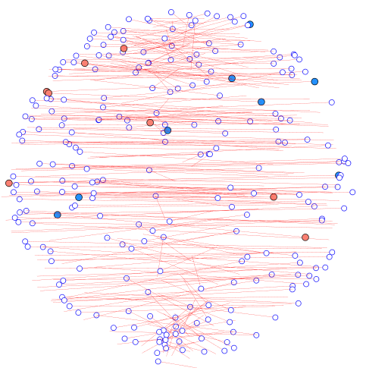
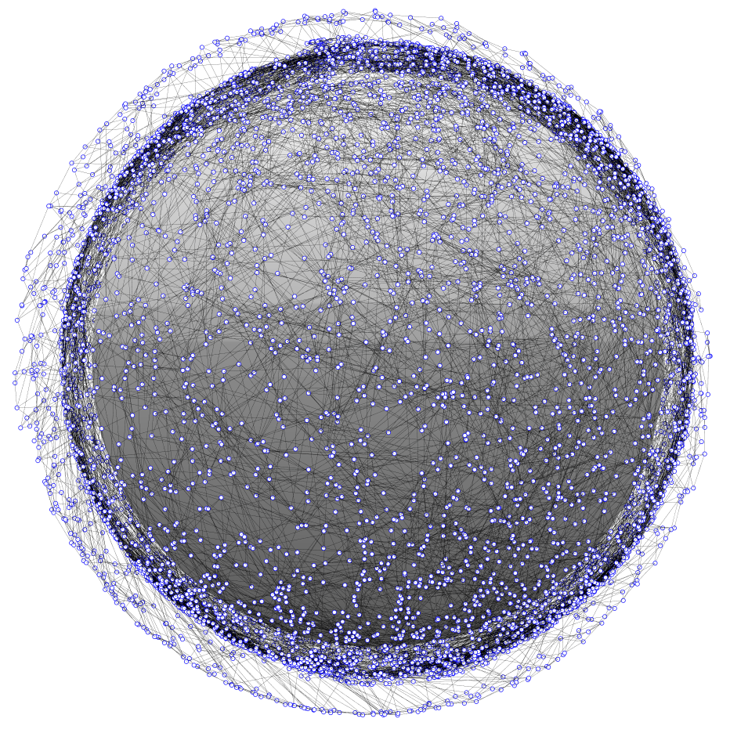
dial – Distributed ad-hoc localization
Rapid and distributed position estimation in a large proliferated satellite constellation
DIAL is for rapidly determining satellite position in a proliferated network. Distributed localization is performed using crosslink and range information.
Can connectivity and crosslink information be used to determine satellite positions?
Rapid localization in large, ad-hoc networked constellations
Current LEO satellites rely on some combination of sensors, GPS, and ground tracking to determine their positions. In a very large ad-hoc network, these methods may be prohibitively time/cost/effort expensive. As large, proliferated constellations come to fruition, position estimation will be a critical issue for operators.
Distributed localization enables parallel computing
Distributed algorithms scale to very large networks
Distributed localization has not been thoroughly investigated in large, ad-hoc, three-dimensional networks. There is a wealth of unique research to be performed.
Leverages wireless terrestrial localization methods
DIAL is an investigation into rapid and distributed position estimation in large proliferated networks. SWaP constraints on proliferated satellites may limit position estimation abilities. Wireless localization algorithms can be computationally low-cost, and performed without the need for a centralized computing resource. Distributed localization can reduce operator and computational workload, which will allow space operators to safely and efficiently manage large networks.
Range-based localization based on ad-hoc networking
DIAL leverages algorithms and methods developed for terrestrial localization in wireless networks. Results from Project Packet are used to initialize the crosslinks and network topology. Multi-Dimensional Scaling (MDS) is used to map the networks with an algorithm called MDS-MAP. A distributed form of MDS-MAP is implemented, called MDS-MAP(P), which enables distributed mapping.
Local neighborhoods are independently mapped and then merged. As the local maps are aggregated into a total map, an absolute map can be constructed with the inclusion of 3 (in 2 dimensions) or 4 (in 3 dimensions) anchors nodes that are position-aware.
Rapid and distributed position estimation in large satellite constellations will address a major challenge for space operators.
1. Use local neighborhood crosslink information to map local patches
2. Merge overlapping patches
Managing Very Large Networks Poses a Challenge to Space Operators
3. Absolutely localize the assembled network using anchor nodes
Justin Kim
841757
Ventures

Slide 3
dial – Distributed ad-hoc localization
Rapid and distributed position estimation in a large proliferated satellite constellation
MDS-MAP was successfully implemented in a centralized 2d case with high accuracy. Position estimation was nearly perfect for networks of up to 10,000 nodes. In the centralized 3d MDS-MAP, the relative map was accurately produced, but the absolute mapping was not accurate. Finding the optimal rotation was done with the Kabsch Algorithm, but it did not produce an accurate transformation. Similar results were observed using a linear least squares transformation.
Extension to the distributed algorithms (MDS-MAP(P)) did not produce accurate results. Very large errors were observed in both the 2d and 3d cases. The inaccurate mapping likely resulted from the process of merging local patches. As the aggregate map expands, each subsequent linear transformation compounds the error. A refinement process between each merging is probably necessary for better results.
Justin Kim
841757
Ventures

Slide 4
dial – Distributed ad-hoc localization
Rapid and distributed position estimation in a large proliferated satellite constellation
Justin Kim
841757
Ventures

Slide 5
dial – Distributed ad-hoc localization
Rapid and distributed position estimation in a large proliferated satellite constellation
Mao33431
Computation of local maps can be done locally at each node in parallel with others
Local maps can be merged in parallel in different parts of the network
As soon as anchors are present in a sub-network, absolute map can be computed
Page 210
Justin Kim
841757
Ventures

Slide 6
Use crosslink ranges to map local patches
Merge overlapping patches

